Slide 1
Machine Learning for National Economic Accounts
Jeff Chen, Abe Dunn, Kyle Hood,
Alex Driessen and Andrea Batch

Slide 2
Motivation
End of
Quarter
Advance
Estimate
Second
Estimate
When we’d
like it to be available
When source
data are available

Slide 3
Motivation
End of
Quarter
Advance
Estimate
Second
Estimate
Short-term prediction using machine learning (for services sector estimates)
Traditional
Data
Alternative
Data

Slide 4

Possibilities: ML for National Economic Accounts
Identify which modeling considerations (e.g. algorithm, data, feature selection) are associated with accuracy gains by PCE services component.
2
1
3
Construct ‘hurricane tracks’ for projected quarterly economic growth to help build consensus that a predicted growth is likely.
Develop a simple framework for evaluating tradeoffs in terms of revision reductions relative to current methods.
M1 vs. M2

Slide 5
Hurdles: There are more variables than records.
Issue
Solution
Traditional statistical methods have trouble with k > n
Many ML methods can efficiently sift through inputs that maximize predictive accuracy.
Id | Y | X1 | X2 | X3 | X4 | X5 | . . . | x999
1
2
3
. .
29
Id | Y | X1 | X2 | X3 | X4 | X5 | . . . | x999
1
2
3
. .
29
Which variables to choose?!
3 1 2
Ranked

Slide 6
Hurdles: Small samples call for different strategies.
Issue
Solution
Typical goal of prediction is to crown a definitive winner among all tested models.
For national accounts, the ideal is to find a general set of approaches that will consistently yield accuracy gains.
M1
M2
M1
M2
Algorithm 2
Algorithm 1
Algorithm 3
0
RMSE
0
RMSE
(While M1 is better than M2, in small samples there is effectively no difference)
(If M1 and M2 are derived from the same algorithm but with different inputs, we can form a strategy around a class of algorithm)

Slide 7
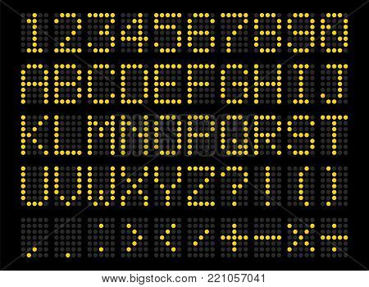
Hurdles: Predictions must beat current methods.
Absolute accuracy of a model is important, but it needs to be contextualized in terms of national economic accounts.
HOME
GUEST

Slide 8

Approach (Part 1): A Prediction Horse Race
Prediction Horse Race
Evaluate Absolute Performance
Identify Best Relative Reductions
$$\left.y_{it}=f_{m}[g_{k}\left(X_{t}, Y_{i,t−p},\right)\right]$$
1
2
3
Predict the Quarterly Services Survey (QSS).

Slide 9
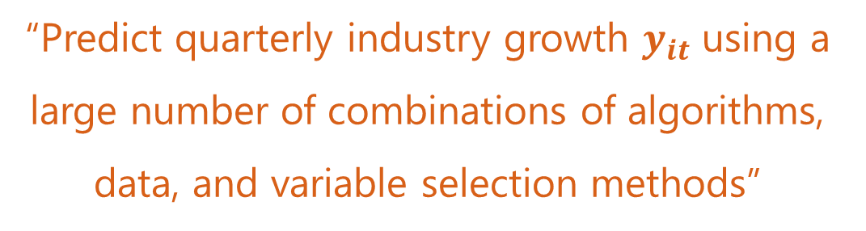
Step 1: A Prediction Horse Race
$$\left.y_{it}=f_{m}[g_{k}\left(X_{t}, Y_{i,t−p}\right)\right]$$
“Predict quarterly industry growth $y_{it}$ using a large number of combinations of algorithms, data, and variable selection methods”

Slide 10
Step 1: Data in Horse Race
Draw on a broad range of potential source data to compare traditional sources and alternative sources.
$$\left.y_{it}=f_{m}[g_{k}\left(X_{t}, Y_{i,t−p}\right)\right]$$
Quarterly
Services
Survey
U.S. Census Bureau
188 industry series
n = 31 quarters
Source data for significant proportion of PCE Services
Credit Card Transactions
First Data – Palantir/ Fed Board Revised Series
192 industries
Lagged QSS
U.S. Census Bureau
188 industry codes lagged for t-4 to t-1
Search Queries
Google Trends
230 associated searches
Current Employment Survey
BLS
140 industries
Consumer Price Index
BLS
600+ indexes

Slide 11


Step 1: Variable Selection Procedures in Horse Race
$$\left.y_{it}=f_{m}[g_{k}\left(X_{t}, Y_{i,t−p}\right)\right]$$
Cherry Picking
Kitchen Sink
Include only conceptually similar variables.
All-in.
25 data set combinations

Slide 12
Step 1: Algorithms in Horse Race
$$\left.y_{it}=f_{m}[g_{k}\left(X_{t}, Y_{i,t−p}\right)\right]$$
4Q Moving Average
Ridge Regression
Extreme Gradient Boosting
Stepwise Regression
CART
Support Vector Machines
LASSO Regression
Random Forest
Multi-Adaptive Regression Splines

Slide 13
Step 1: Algorithms in Horse Race
$$\left.y_{it}=f_{m}[g_{k}\left(X_{t}, Y_{i,t−p}\right)\right]$$
4Q Moving Average
Ridge Regression
Extreme Gradient Boosting
Type of Method
Univariate
Multivariate Regression
Non-Linear or Non-Parametric
Stepwise Regression
CART
Support Vector Machines
LASSO Regression
Random Forest
Multi-Adaptive Regression Splines

Slide 14
Step 1: Algorithms in Horse Race
$$\left.y_{it}=f_{m}[g_{k}\left(X_{t}, Y_{i,t−p}\right)\right]$$
4Q Moving Average
Ridge Regression
Extreme Gradient Boosting
Interpretation
Linear Interpretation
Other Interpretation
None
Stepwise Regression
CART
Support Vector Machines
LASSO Regression
Random Forest
Multi-Adaptive Regression Splines

Slide 15
Step 1: Algorithms in Horse Race
$$\left.y_{it}=f_{m}[g_{k}\left(X_{t}, Y_{i,t−p}\right)\right]$$
4Q Moving Average
Ridge Regression
Extreme Gradient Boosting
Single or Ensemble (many in one)
Single
Ensemble
Stepwise Regression
CART
Support Vector Machines
LASSO Regression
Random Forest
Multi-Adaptive Regression Splines

Slide 16
Methods: A Prediction Horse Race
Train
Test
For Later Iterations
1
2
3
4
5
6
7
Train
Test
For Later Iterations
Iteration
t-5 t-4 t-3 t-2 t-1 t t+1 t+2 t+3 t+4 t+5
Time

Slide 17
Methods: A Prediction Horse Race
886,608 models were trained,
based on the combinations of
industry
x
data sets
x
algorithm
x
variable selection
x
time period

Slide 18
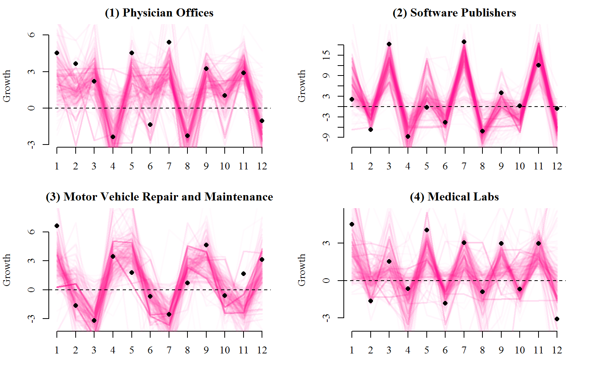
Prediction tracks show how persistent a growth pattern is considering many different modeling scenarios.

Slide 19
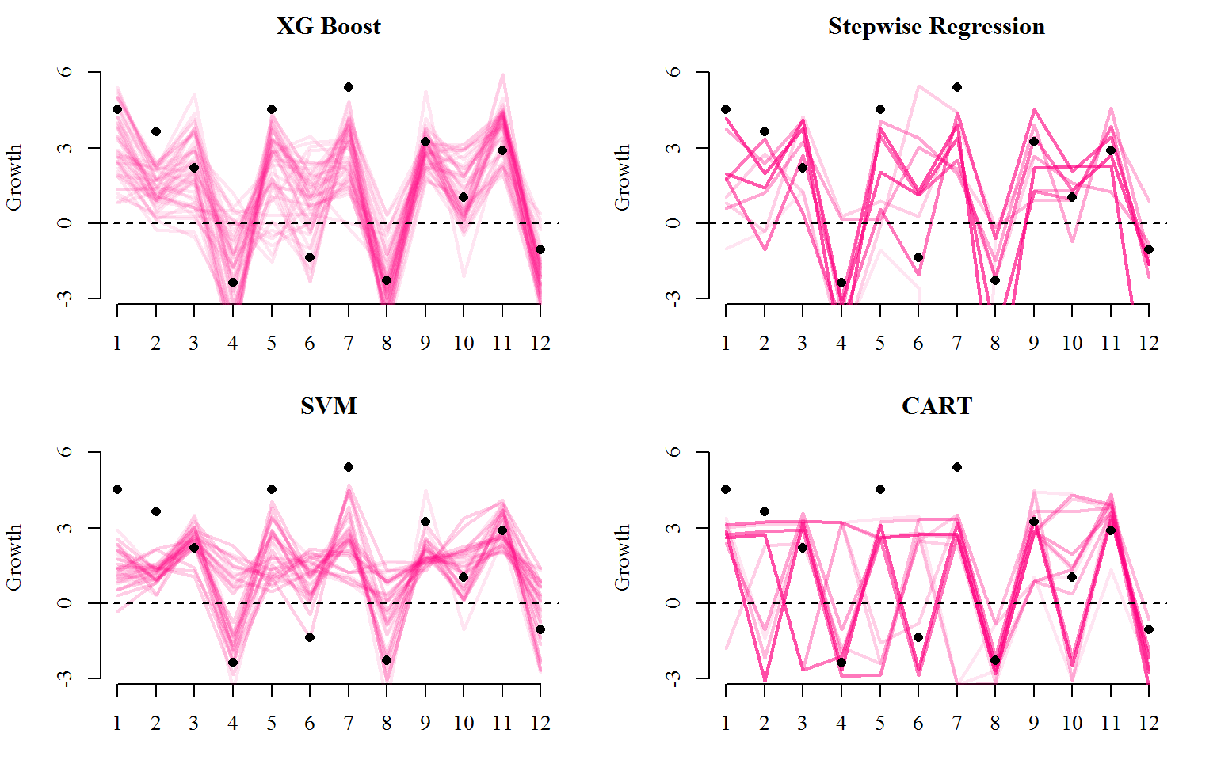
Some algorithms are more flexible in accounting for different ways of integrating information.
NAICS 6211: Physician Offices

Slide 20

Approach (Part 2): A Prediction Horse Race
Prediction Horse Race
Evaluate Absolute Performance
Identify Best
Relative Reductions
$$\left.y_{it}=f_{m}[s_{k}\left(X_{t}, Y_{i,t−p},\right)\right]$$
1
2
3
Measure what generally leads to an accuracy increase in the QSS

Slide 21
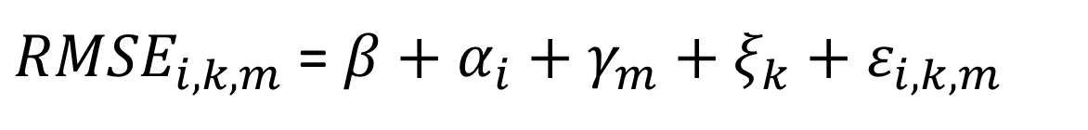
Step 2: Average Absolute Accuracy
${RMSE}_{i,k,m}$ = $β+α_{i}+γ_{m}+ξ_{k}+ε_{i,k,m}$
Estimate a fixed-effects regression to parse out the average accuracy gain associated with each algorithm, data set, etc.

Slide 22
Results: Average RMSE Improvement (Algorithms)

Slide 23
Results: Average RMSE Improvement (Data)

Slide 24
Methods: A Prediction Horse Race
Prediction Horse Race
Evaluate Absolute Performance
Identify Best
Relative Reductions
$$\left.y_{it}=f_{m}[g_{k}\left(X_{t}, Y_{i,t−p},\right)\right]$$
1
2
3
Convert QSS into PCE and find sure-fire improvements compared with current

Slide 25
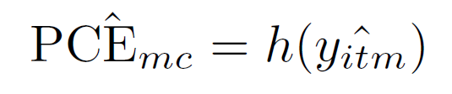
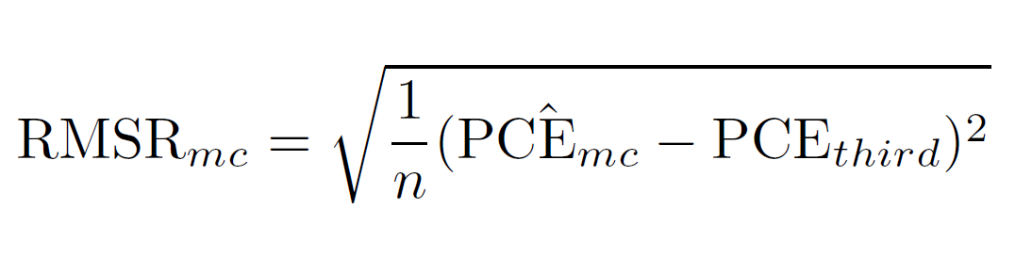
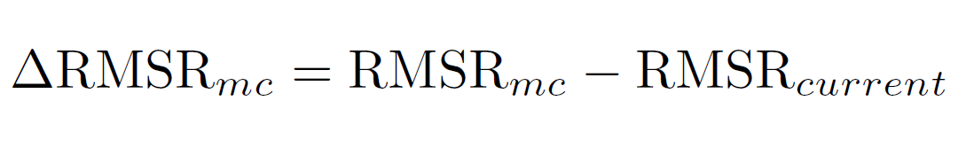
Step 3: Calculate Average Dollar Reduction in Revisions
1
Convert QSS into predictions of PCE services components
2
Calculate on average revision if prediction is used
3
Calculate on revision reduction relative to current methods

Slide 26
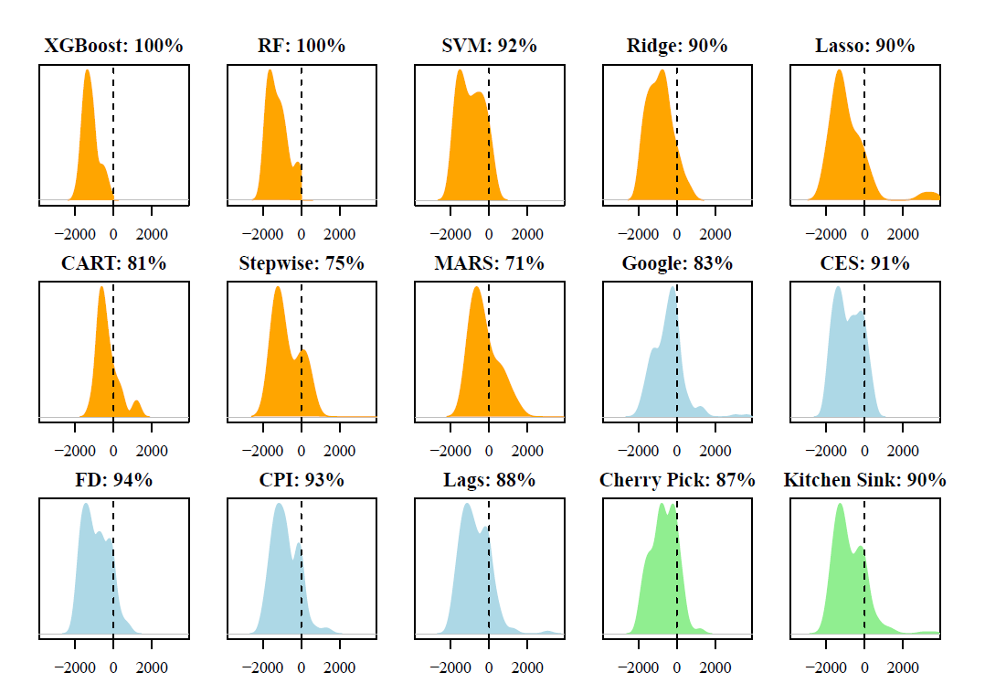
Physician Services: High Chance of Revision Reduction

Slide 27
Physician Services: High Chance of Revision Reduction

Slide 28
Example: What’s the trade off between $\hat{β}$and $\hat{y_{i}}$?
vs.
Stepwise regression is 25% less likely to yield a revision reduction to physician services when compared with the best method.

Slide 29
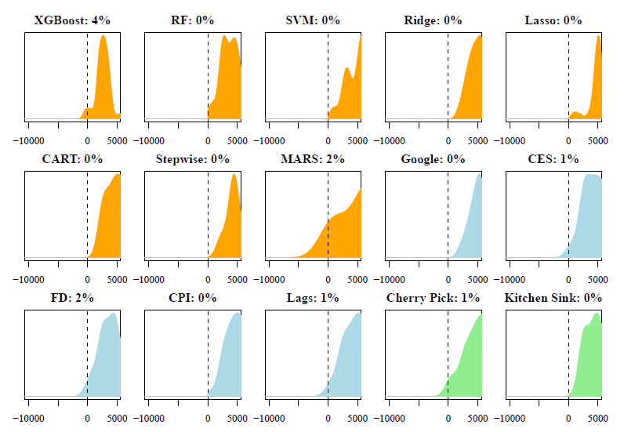
Non Profit Hospitals: Less Useful Result

Slide 30
Next Steps
Construct a “moneyball” set of algorithms that yield marked wins for the home team.

Slide 31
Jeffrey.Chen@bea.gov

