Slide 1
GDP & Beyond: Priorities and Plans
Steve Landefeld, Shaunda Villones, and Alyssa Holdren

Slide 2
GDP as a Measure of Welfare (and Production)
Long-standing issue
Kuznets
Proxy for Standard of Living
Renewed interest in broader, or supplemental, measures
Housing and financial crisis
“Great recession” and slow recovery
Environment, natural resources, energy; investment (including human capital) and saving; and R&D and innovation
Rising health care costs
Increasing globalization
Increasing concentration of income and wealth
Challenges: Varying degrees of—gaps in data, consensus on estimating methods, and the relevance and importance of these extended accounts
How broad?
National accounts should include elements that reflect economic welfare that can be brought directly or indirectly into relation with the measuring rod of money. –Pigou
He emphasized that “can” might mean anything from “can easily” to “can with violent straining.”
Progress on broader measures has waited too long (over 75 years!)
Need to set ambitious but achievable goals

Slide 3
Developing a Work Plan
Will address short-term and long-term Supplemental Account priorities and will include the following elements
Scope and Methodology
Recommended long-term projects—extended national accounts, measures of subjective well-being, and dashboards of economic and other social indicators
Recommended short-term projects—updating/extending one or more of the sets of existing satellite accounts that BEA currently produces or has produced in the past
Update will serve as a prototype and catalyst for further extensions and updates for other areas of BEA’s economic accounts.
Availability of source data
Required resources
Communication plan
Vet the work plan
Produce prototype satellite account(s)

Slide 4
Better Measure of Production and Economic Welfare
Long-standing issue with lots of research to build on
Kuznets: GNP is a measure of market production and incomes, not a measure of economic welfare. Other problems: Distribution of income, externalities of modern life, depletion, etc.
Nordhaus and Tobin: Sustainability, value of leisure, non-market production, measure of economic well-being (MEW)
Solow, Jorgenson et al. and Hulten: Better understanding of the sources of growth and GDP as a better measure of production (and welfare)
Gordon, Berndt, Corrado & Sichel, Bosworth and Triplett, Boskin Commission, BEA/BLS/Census: Improving GDP as a measure of production and welfare through better measures of prices and real output
Nordhaus/Nature’s Numbers: Expanding GDP to include the environment (including natural resources)
Abraham/Beyond the Market: Designing non-market accounts for the United States
Stiglitz, et al.: Distribution of income, consumption, and wealth; household production and leisure time; sustainability, subjective measures of well-being, and physical indicators (health, education, environment, etc.)
Hulten, Corrado, and Sichel: Innovation
BEA: GDP and Beyond

Slide 5
Subjective Well-Being Indexes
Attempts to measure well-being using direct surveys and avoids some problems in GDP per capita and other economic measures
SWB comes with its own problems
Several problems for use in public policy
SWB adapts quickly to negative events (even with no improvement in underlying conditions such as loss of wealth, recessions, disability, etc.) reducing usefulness for policy
No clear long-term trend in happiness, which also limits usefulness for policy
Cultural and attitudinal differences across countries make cross-country comparisons difficult

Slide 6
Happiness and the Financial Crisis
Gallup well-being index
Unemployment rate
Household net worth
Source: BLS, Gallup, FRB

Slide 7
Long-Term Happiness and Real GDP Per Capita
Source: BEA, University of Michigan, Veenhoven, R., World Database of Happiness, Distributional Findings in Nations

Slide 8
Dashboard of Social Indicators
Subjective weights (including equal weights) vs. market values?
Subjective choice of indicators?
Appropriateness/representativeness of available indicators as measures of types of well-being?

Slide 9
Inventory of current projects
I. For possible updating, extending, or moving from research to production
Arts and Cultural Production Satellite Account
Energy Satellite Account
Environmental and Natural Resources Satellite Accounts:
National Capital
Ocean Economy
Global Value Chains/Extended International Satellite Account
Government Satellite Accounts
Health Care Satellite Account
Household Production Satellite Account
Human Capital Satellite Account
Income, Consumption, and Wealth Distribution Satellite Accounts
Integrated Income, Product, and Federal Reserve Financial Accounts (more on next slide)
Integrated BEA GDP-BLS Productivity Accounts
Integrated BEA/BLS Industry-Level Production Account
Outdoor Recreation Satellite Account
Small Business Satellite Account
Travel and Tourism Satellite Accounts

Slide 10
Potential Projects: II. Updates to Make GDP a Better Measure of Welfare and Production
Digital economy
Prices for new goods
Prices for “free goods”
Other updates to GDP

Slide 11
Potential Projects: III. Dashboard of Existing Measures
Highlight existing data on economic well-being, including relative measures
GDP per capita and other per capita measures
GDP, NDP, GNP, command-basis GDP, etc.
Saving, net investment, and other rates and shares of GDP

Slide 12
UK Example of Alternative Measures of Economic Well-Being
Impact of alternative measures: GDP, NDP, GNI, NNI, HHDI, HHFCE, HHAFCE (see charts)
Quarterly: 10 main indicators
Gross domestic product per capita
Net national income per capita
Real household disposable income per capita
Real household final consumption expenditure per capita
Real median equivalized household disposable income (survey data)
Whole economy net wealth
Household net wealth
Perception of financial situation
Unemployment rate
Inflation (CPI)
National well-being: Mix of alternative economic, physical, and subjective measures of 10 dimensions

Slide 13
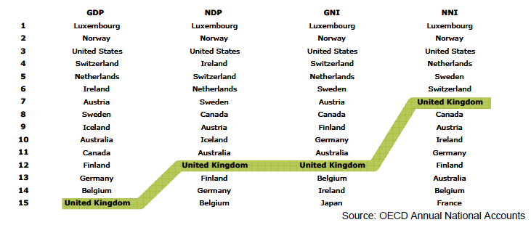
Impact of Alternative Measures: National Income
Measures of National Income, 2008
[Current Prices and PPPs]

Slide 14
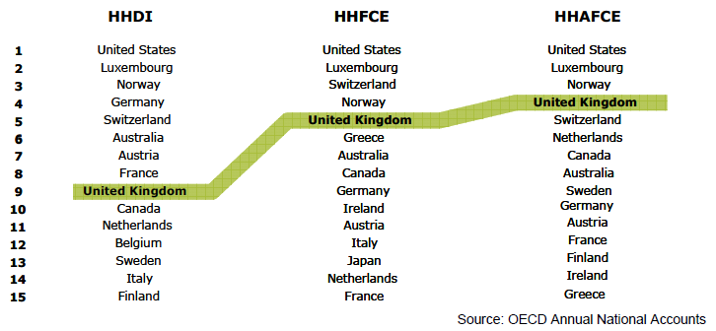
Impact of Alternative Measures: Household Income
Measures of Household Income, 2008
[Current Prices and PPPs]

Slide 15
UK Example of Alternative Measures of Economic Well-Being
Impact of alternative measures: GDP, NDP, GNI, NNI, HHDI, HHFCE, HHAFCE (see charts)
Quarterly: 10 main indicators
Gross domestic product per capita
Net national income per capita
Real household disposable income per capita
Real household final consumption expenditure per capita
Real median equivalized household disposable income (survey data)
Whole economy net wealth
Household net wealth
Perception of financial situation
Unemployment rate
Inflation (CPI)
National well-being: Mix of alternative economic, physical, and subjective measures of 10 dimensions

Slide 16
Potential Projects: IV. Aggregate Economic Welfare Indexes
Jorgenson et al. (level of living/standard of living)
Jones and Klenow (market-based index of consumption, leisure, mortality, and inequality)

Slide 17
Potential Projects: V. What BEA Could Contribute to SWB Indicators
Subjective well-being indexes
BEA statistical toolkit of existing and supplemental information to aid research in understanding the determinants of Subjective Well-Being survey results including:
The distribution of personal income and wealth
National and regional price indexes
Sustainability measures
Well-being indicators/dashboards
BEA statistical toolkit of existing and extended indicators as inputs to aggregated (usually with equal weights, e.g. Canadian Well-Being Index) and dashboard indicators (e.g. OECD’s “How’s Life”) including:
Existing measures, including household income and wealth
Extended measures, including human capital, environment, health and education

Slide 18
Criteria for Evaluation of Various Satellite/Supplemental Accounts (Potential Projects I–V)
How close are they to BEA’s mission and expertise?
How relevant and useful are they to public policy?
How often do they need to be produced?
What are the resource costs to begin regular production? (And benefits relative to core research)
What is the methodology and what is the availability of source data?
Accuracy, Timeliness, Relevance, Objectivity and Use of Economic Methods
Why should BEA rather than others produce these accounts?
What is their importance to Customers, Experts, Policy Makers, Business Users, Congress and the Administration?
How successfully can BEA vet and roll out the alternative accounts?

Slide 19
Developing a Plan to Integrate, Prioritize, and Regularly Produce Extended Account Estimates
Questions for the Committee
Are there projects that should be added to, or deleted from, the list of potential projects?
Are there criteria that should be added to, or deleted from, the criteria list?
Given BEA’s objectives and the criteria cited above, what would be your suggested top priorities for BEA short-term (1 year) and long-term?

