Slide 1

Discussion of “Machine Learning National Economic Accounts”
Patrick Bajari
VP Core AI and Chief Economist, Amazon

Slide 2
Outline
Quick summary
A quick overview of some ML
Suggestions for this and related problems

Slide 3
Overview
Problem- source data is not available at time of advanced estimate
Solution- use Machine Learning:
Step 1: Predict industry level output using credit card data, Google trends, CES and CPI
Step 2: Predict aggregate PCE services
ML is a very logical way to deal with missing data and in many settings will outperform naïve imputation or standard econometric models
Sensible step by the agencies

Slide 4
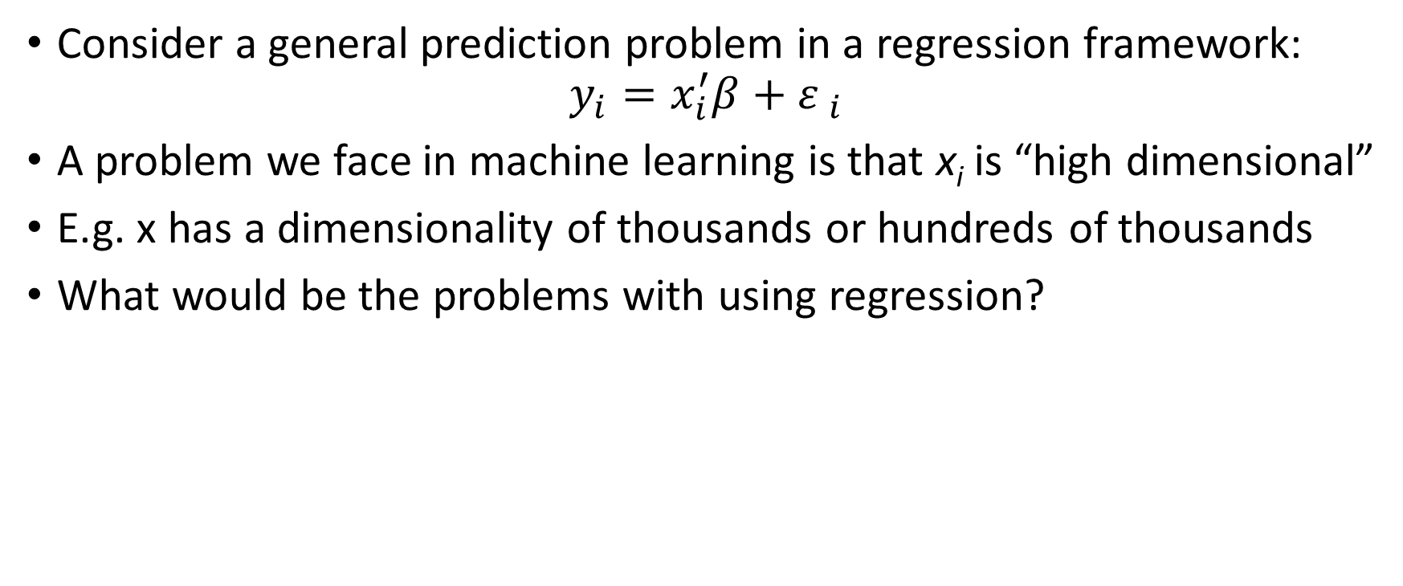
Machine Learning
Consider a general prediction problem in a regression framework:
$$y_{i}=x_{i}^{′}β+{ε }_{i}$$
A problem we face in machine learning is that x_{i} is “high dimensional”
E.g. x has a dimensionality of thousands or hundreds of thousands
What would be the problems with using regression?

Slide 5
Problems with regression
Identification: i.e. K>N
Multi-collinearity:
-While the number of variables is large, many of them are likely to be highly collinear
-Regression coefficients large positive and large negative values
-High in sample fit but poor out of sample fit

Slide 6
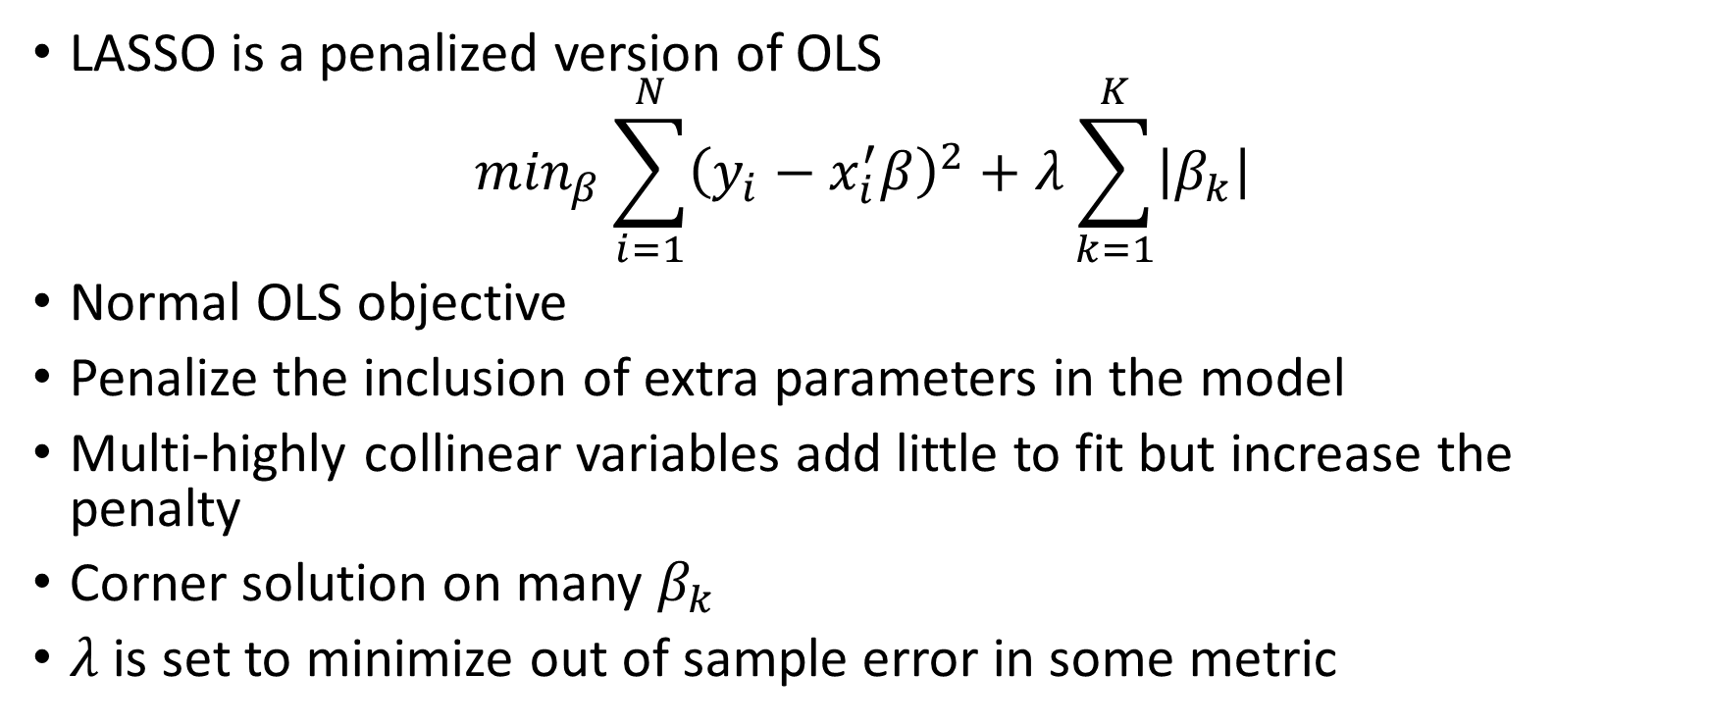
Regularization
LASSO is a penalized version of OLS
$$\min_{β}\sum_{i=1}^{N}{{\left(y_{i}−x_{i}^{′}β\right)}^{2}}+λ\sum_{k=1}^{K}{\left|β_{k}\right|}$$
Normal OLS objective
Penalize the inclusion of extra parameters in the model
Multi-highly collinear variables add little to fit but increase the penalty
Corner solution on many $β_{k}$
$λ$ is set to minimize out of sample error in some metric

Slide 7
Tree Model
X₁<5
X₁>5
X₂<3
X₂>3
X₂<7
X₁>7
y=4
y=2
y=7
y=1

Slide 8
Random Forest and Residuals
Tree allows for non-linear interactions between variables
Random forest is an ensemble (average) of many trees where we randomly draw covariates for each tree
Boosting builds trees by examining fitted residuals

Slide 9
Suggestions
Below are some suggestions which may (or may not) improve accuracy
Some of the suggestions are a bit incomplete and may be more relevant in other settings
Hard to know which suggestions are most valuable but some of them are easily tested

Slide 10
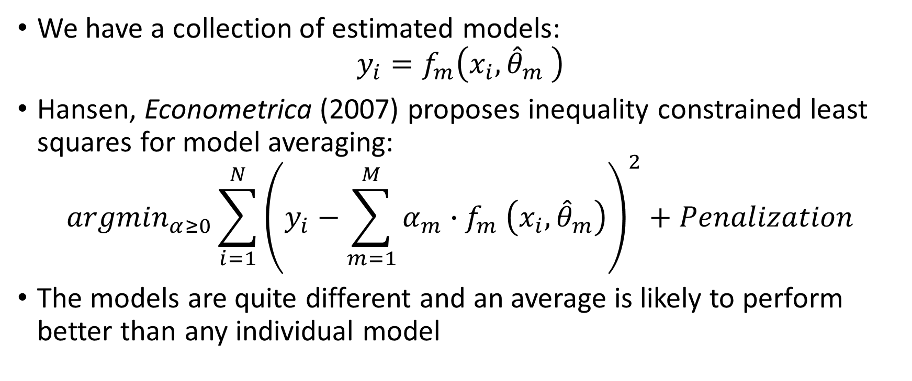
Model averaging
We have a collection of estimated models:
$$y_{i}=f_{m}\left(x_{i},{\hat{θ}}_{m} \right)$$
Hansen, Econometrica (2007) proposes inequality constrained least squares for model averaging:
$${argmin}_{α≥0}\sum_{i=1}^{N}{{\left(y_{i}−\sum_{m=1}^{M}{α_{m}{∙f}_{m}\left(x_{i},{\hat{θ}}_{m}\right)}\right)}^{2}+Penalization}$$
The models are quite different and an average is likely to perform better than any individual model

Slide 11
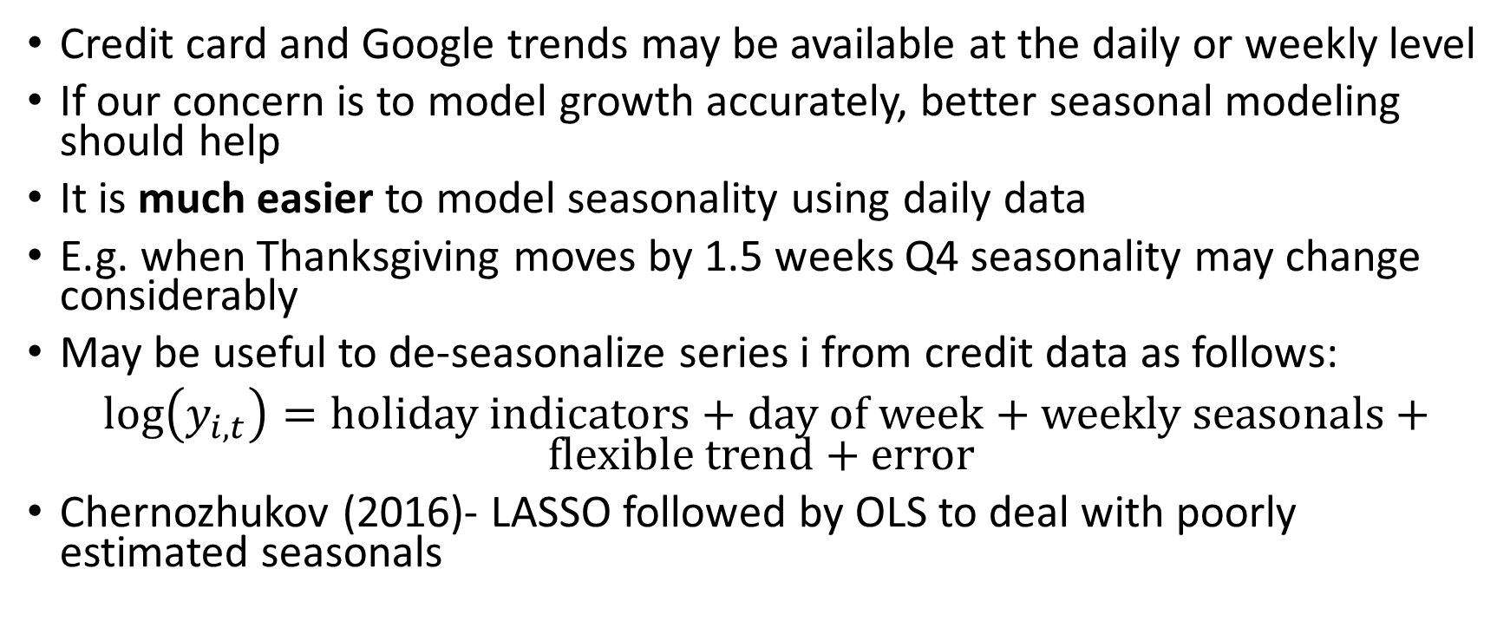
Daily/weekly data
Credit card and Google trends may be available at the daily or weekly level
If our concern is to model growth accurately, better seasonal modeling should help
It is much easier to model seasonality using daily data
E.g. when Thanksgiving moves by 1.5 weeks Q4 seasonality may change considerably
May be useful to de-seasonalize series i from credit data as follows:
$log\left(y_{i,t}\right)=holiday indicators+day of week+weekly seasonals+flexible trend+error$
Chernozhukov (2016)- LASSO followed by OLS to deal with poorly estimated seasonals

Slide 12
Daily/weekly data
The credit card data is a panel
You can pool seasonal factors across series i
Hierarchical modeling could help:
Seasonal industry i=common factor + industry i specific component
The panel can account for common irregular time effects that change demand, e.g. Olympics, Brexit, Trump election
Weight regressions by distance from current date for evolving seasonality

Slide 13
Daily/weekly data
Would be nice to disaggregate credit card, Google trends data by geography
Weather are examples of common time effects by geography and could be captured by model
The common time effects, seasonals, trends, etc… could be use as features
In some cases you may want to work with de-seasonalized data or model growth rates directly

Slide 14
Hierarchical Models
At Amazon we have a related problem- forecast sales for tens of thousands of product lines
We care both about the individual product lines and total sales
We have found that hierarchical models combined with ML are useful
In a hierarchical model you would specify that:
Aggregate PCE Service Expenditure=sum of individual industries
Individual industry=ML model of industry output

Slide 15
Hierarchical Models
Hierarchical modeling provides logical consistency- e.g. individual forecasts sum to aggregate forecast (doesn’t seem to be imposed here)
If you estimate the equations jointly you might gain efficiency
Imposing true restrictions (e.g. total is sum of parts) might also help efficiency
There are formal Bayesian techniques for joint estimation of hierarchical models
We often find it useful to forecast the top level of the hierarchy and predict industry output as shares
This might give you a more logical approach to de-seasonalizing data when you need aggregates and industry level data to add up
Problem: mixed frequency data and ML model
Problem: a hierarchy formed with your current set of models is not a solved problem

