Slide 1
Overview of the Foundations for Evidence-Based Policymaking Act of 2018
Advisory Committee on Data for Evidence Building
October 23, 2020

Slide 2
What is the Evidence Act?
Background: The Commission on Evidence-Based Policymaking
Established by 2016 bipartisan legislation (Speaker Paul Ryan and Senator Patty Murray)
Wide variety of expertise (Program Evaluation, Statistics, Economics, Data Governance, Privacy)
Produced 22 recommendations to encourage:
  Systematic Planning for Evidence-Building
  High Quality Data Governance
  Coordinated Support for Privacy-Protected Data Sharing

Slide 3
What is the Evidence Act?
Background: Foundations for Evidence-Based Policymaking Act of 2018
Introduced by Speaker Paul Ryan and Senator Patty Murray after the release of the Commission report in September 2017
Addresses 11 of the Commission’s 22 recommendations
Signed by the President and enacted into law on January 14, 2019 as P.L. 115-435
Includes three Titles:
  Title 1—Federal Evidence-Building Activities
  Title 2—Open Government Data Act
  Title 3—Confidential Information Protection and Statistical Efficiency (CIPSEA)

Slide 4
The Evidence Act’s 3 Big Ideas
Evidence-Based Policymaking Requires Systematic Planning
Effective Federal Data Asset Use Requires High-Quality Data Governance (including Open Data Planning)
Safely Expanding Access to Protected Data for Evidence-building

Slide 5

The Evidence Act’s 3 Big Ideas (2)
Evidence-Based Policymaking Requires Systematic Planning
Effective Federal Data Asset Use Requires High-Quality Data Governance
Safely Expanding Access to Protected Data for Evidence-building
  Start by identifying high-value questions to address
  Strategize approaches to obtaining answers
  Assess capacity and needs
  Maintain portfolio of current and planned activities
Learning Agendas
Capacity Assessments
Evaluation Plans
Evaluation Officers
Statistical Officials
Chief Data Officers
The Federal Data Strategy is an initiative under the President’s Management Agenda

Slide 6
The Evidence Act’s 3 Big Ideas (3)
Evidence-Based Policymaking Requires Systematic Planning
Effective Federal Data Asset Use Requires High-Quality Data Governance mw and existing officials (e.g., CDO, statistical, c
Safely Expanding Access to Protected Data for Evidence-building
  Coordination of responsibilities among new and existing officials
  Data Management (e.g., data inventories and information collection review)
  Open Data Planning: making appropriate data
  available to the public
CDO Council
Open Data policy
Open Data Plans
Data inventories
Federal Data Catalog

Slide 7
The Evidence Act’s 3 Big Ideas (4)
3. Safely Expanding Access to Protected Data for Evidence-building
  Identify trusted intermediaries
  Articulate high standards
  Empower trusted intermediaries to access data
  Ensure effective provision of data to evidence-builders
  Build tools and infrastructure
Transparent process for recognizing statistical agencies and units
Reauthorize confidentiality law
Codify Statistical Directive #1 (the “Trust Directive”)
Presumption of Access
Expand Secure Access to CIPSEA Assets
Standard Application Process
Advisory Committee on Data for Evidence Building

Slide 8
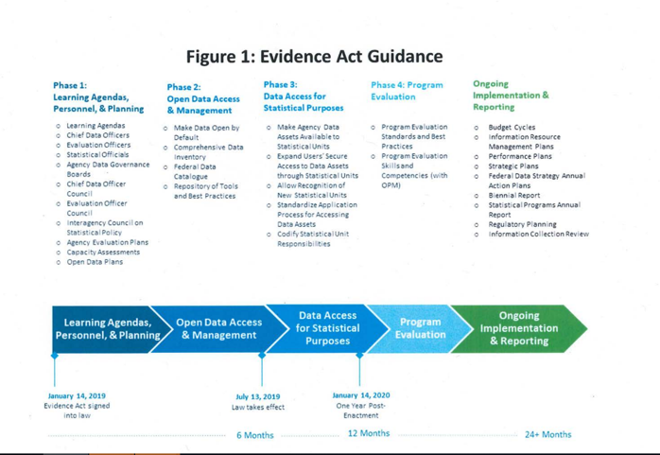
Implementation Roadmap
From OMB Memorandum M-19-23

