Slide 1
State Perspectives Anna Hui Elisabeth Kovacs Christin Lotz Kimberly Murnieks
Advisory Committee on data for Evidence Building (ACDEB) Meeting
December 18, 2020

Slide 2
Agenda
Briefing Structure
How we look at evidence
How we are organized for evidence and data
Our state-specific considerations
Missouri -- Anna Hui
South Carolina -- Elisabeth Kovacs
Tennessee -- Christin Lotz
Ohio -- Kimberly Murnieks
Overall State Level Challenges & Issues

Slide 3
Missouri – Anna Hui
How We Look at Evidence
During the annual budget process, the Office of Administration Office of Budget and Accounting requires state agencies to provide both financial and program performance metrics in the budget submissions.
Budget Explorer - https://oa.mo.gov/budget-explorer
State’s COVID response has relied heavily on data to support emergency declarations and next steps; evidence is utilized daily in statewide COVID Fusion Cell discussions; Show Me Strong Recovery interactive website provides data transparency on public health, economy and social impact - https://showmestrong.mo.gov/data/

Slide 4
Missouri – Anna Hui
How We Are Organized in Our State For Evidence and Data
Decentralized - Each agency has specific program requirements for data collection and reporting according to state and federal statutes.
State Chief Information Officer (CIO), under the Office of Administration, guides data security and usage from IT perspective, works with Governor’s Office and Cabinet agencies on planning future state for data governance and organization for state; state legislators have proposed creating a State Data Officer role under State CIO
Missouri Economic Research and Information Center (MERIC) under the Missouri Department of Higher Education and Workforce Development (DHEWD) serves as the state’s labor market information shop
Missouri Data Governance Committee was created with the Workforce Data Initiatives (WDI) federal grant to improve collection and data-sharing; resulted in creation of the Missouri Score Card and Wage Finder application

Slide 5
Missouri – Anna Hui
Our State-Specific Considerations
Since 2018, Missouri has partnered with the Coleridge Initiative to train State of Missouri staff through their Applied Data Analytics Program.
Training covered core data analytics techniques by working on specific projects using real-world micro-data. During this training, students have access to the Administrative Data Research Facility (ADRF) which provides a secure platform to host confidential micro-data. The ADRF is designed to promote collaboration, facilitate documentation, and provide information about use to data stewards. Missouri is considering using the ADRF for expanding internal data analytics.
In 2019, Missouri partnered with Illinois, Indiana, Ohio and Kentucky to form the Midwest Data Collaborative with the intent to create a regional data-sharing framework.
A variety of research partnerships exist with the University of Missouri system as well as other private higher education institutions, like the Washington University in St. Louis

Slide 6
South Carolina – Elisabeth kovacs
How We Look at Evidence
Policy and budget decisions are made based on data analysis.
Individual agencies utilize various data systems to collect, disseminate and analyze their own data.
Opportunity for a better mechanism for data administration for workforce and education to better align training and industry needs.

Slide 7
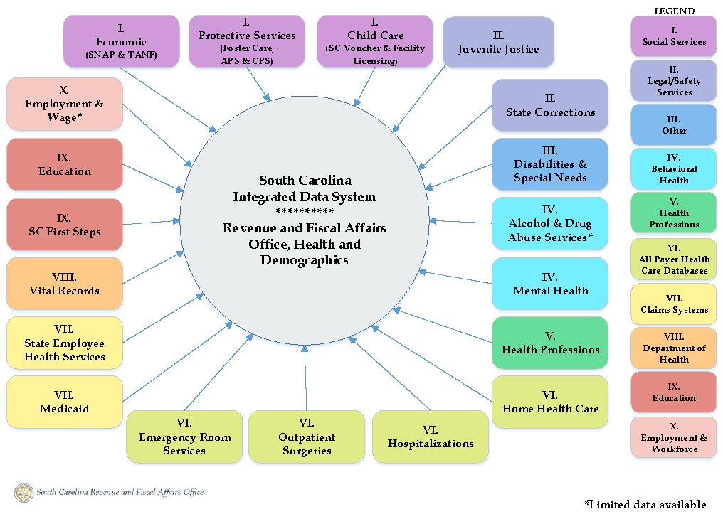
South Carolina – Elisabeth kovacs
How We Are Organized in Our State For Evidence and Data
Mostly decentralized; however healthcare data is centralized within our Office of Revenue and Fiscal Affairs.

Slide 8
South Carolina – Elisabeth kovacs
Our State-Specific Considerations
Governance Policy
Advancing data governance among stakeholders.
Understanding actual versus the perceived restrictions in sharing data.
Data Sharing Process Management
Identifying and prioritizing initiatives mutually beneficial to stakeholders.
Information Technology
More efficient ways to inventory, document and manage data with an emphasis on data security.
Data Sharing Outcomes and Evaluation Metrics
8

Slide 9
Tennessee – christin lotz
How We Look at Evidence
Inventory the Base Budget:
Determine what programs we fund, how much funding there is for each, and their level of evidence.
Include Evidence in Cost Increase/Reduction Plans:
Provide a tool for departments to use that explains the level and type of evidence tied to cost increases.
Streamline Data Management to Improve Data Usage:
Improve the ability for agency data sets to speak to one another in order to answer meaningful questions about program impact.

Slide 10
Tennessee – christin lotz
How We Are Organized in Our State For Evidence and Data
Evidence – centralized with the Office of Evidence and Impact
Data – collection and analysis at agency level currently
Transparent TN dashboards
https://openmaps.tn.gov/

Slide 11
Tennessee – christin lotz
Our State-Specific Considerations
Focused on data sharing between executive branch agencies
Overcoming barriers to data sharing
Maintaining privacy and security
Data analytics at the enterprise level
11

Slide 12
OHIO – kim murnieks
How We Look at Evidence
Ohio reviews data as part of our state budget planning process
State law allows for program performance reviews by the Office of Budget and Management
State agencies submit notable statistics as part of their budget requests
Individual agencies conduct program performance reviews and evaluations
Ohio recently established the data.ohio.gov data portal to bring together our data, research, and reports to drive meaningful insights and results

Slide 13
OHIO – kim murnieks
How We Are Organized in Our State For Evidence and Data
InnovateOhio = data governance and common data technology platform
InnovateOhio is established in state law within the Governor’s Office and is led by our Lieutenant Governor
Dashboards managed by agencies including
Ohio Checkbook interactive budget site https://checkbook.ohio.gov/
COVID Dashboard https://coronavirus.ohio.gov/wps/portal/gov/covid-19/dashboards
Unemployment Claims Dashboard https://ui-claims.chrr.ohio-state.edu/
All accessible through https://data.ohio.gov/wps/portal/gov/data/home

Slide 14
OHIO – kim murnieks
Our State-Specific Considerations
IT optimization and centralization
IT innovation
Digital experience
Data analytics
Shared services and collaboration
All focused on leveraging data and technology to better serve Ohioans
14

Slide 15
Overall State-Level challenges & Issues
Lack of Incentives | Culture of Government Data | Social Impact
Federal government has only recently required data in federal funding. | Government programs are often linear, focused on one population or one outcome. | Public distrust of protected data due to numerous instances of data vulnerability.
Lack of federal inter-agency data sharing. | Natural protective instinct of “my own” agencies data. | Fear of “big brother” managing individuals through data.
Additional resources to integrate state data sources moves state decision. | Natural tendency to make decisions that minimize risk rather than maximize outcomes. | Privacy and security concerns
No standardized reporting framework (data definitions) at the federal level and required different times of the year (PY, FY, State FY, etc). | Federal laws that deter or prevent cross-agency data sharing
Legacy data systems | Balancing compliance and results

