Slide 1
Advisory Committee on Data for Evidence Building
Local Perspectives David Park (NLC)
December 2020 Laila Alequresh (Dallas)

Slide 2
Background Questions
What are things about cities that the Federal government should know?
What are the major gaps to achieving the objectives of the Foundations for Evidence-Based Policymaking Act?

Slide 3
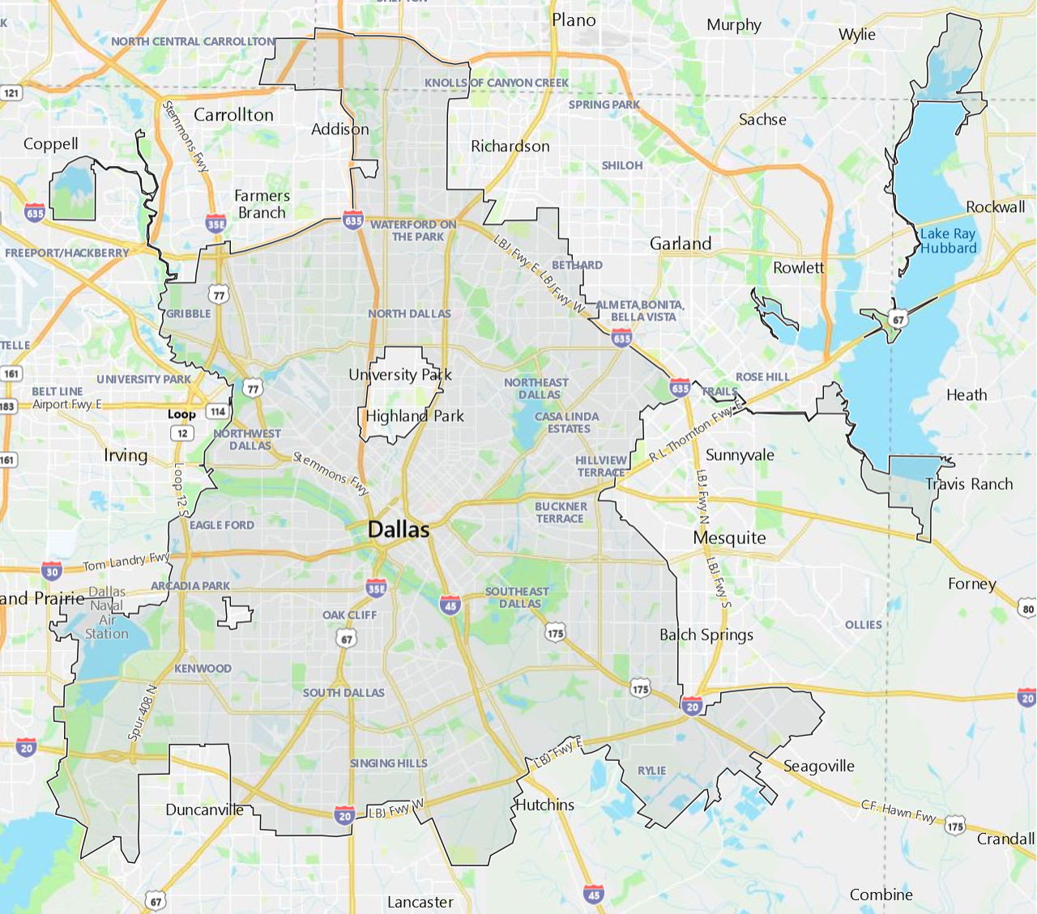
Census Forms of Local Government (Count)
County (3,031)
Municipalities (19,495)
Townships (16,253)
School Districts (14,061)
Source: 2017 Census of Governments
Defn. “political subdivision within which a municipal corporation has been established to provide general local government for a specific population concentration in a defined area.”

Slide 4
Characteristics of Municipalities
Pop Range: 1 in Minowi Village, NE to 8.4M in New York City, NY
Total Pop in Municipalities: 210M (63% US)
Average Pop Size: 10,600
Average Municipal FTEs: 120
Source: 2018 Census Pop Est., 2018 Annual Survey of Public Employee and Payroll

Slide 5
Challenges by Pop Category
Pop Category | # of Cities in Category | Total Pop in Category | Challenge(s)/Issue(s)
<1,000 | 9,200 | 3.6M | No full- or part-time staff. Ex: Philly suburb Rose Valley, PA (Pop: 950); rural farm community Bremond, TX (Pop: 950)
1,001-4,000 | 4,922 | 10.2M | Limited online staff directories. Ex: Indy suburb Morristown, IN (Pop: 1,300); rural logging community Coquille, OR (Pop: 3,900)
4,001-20,000 | 3,543 | 32.3M | Online municipal services. Ex: Lowell, MI (Pop: 4,200) small town near Grand Rapids; Orlando suburb Longwood, FL (Pop: 15,100)
20,001-64,999 | 1,259 | 44.3M | Open data portals. Ex: college town Oxford, MS (Pop: 24,500); micropolitan area Aberdeen, SD (Pop: 28,600)
65,000+ | 575 | 115.7M | ACS 1-yr pop est. threshold. Ex: Youngstown, OH (Pop: 65,000); DC suburb Frederick, MD (Pop: 72,100)
Source: 2018 Census Pop Est., NLC research

Slide 6

Federal Funding and Reporting Chain
Regional governmental agencies (e.g., Council of Governments, Metropolitan Planning Organizations)
Federal
State
County
City

Slide 7
COVID/Crisis Reporting
Public health authority
Local government
Federal
State
Public health authority/
Local government

Slide 8
Smaller cities
Larger cities
Challenges at the local level
Reporting requirements
Granular comparison data
Ease of locating information
Employee data skills/expertise

Slide 9
Solutions should be:
Accessible
Equitable
Intuitive

